Slide 1
Psalms
Lesson 3
The Lord Reigns

Slide 2
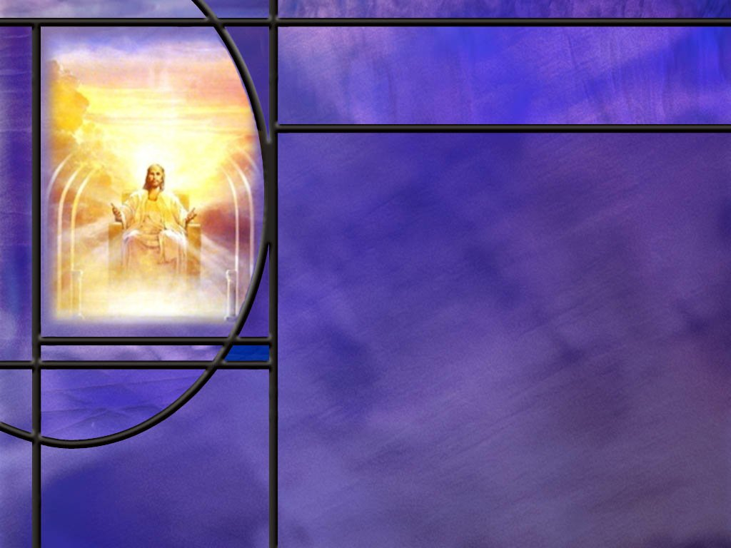
Memory Text
Psalm 93:1 NIV
The LORD reigns, he is robed in majesty; the LORD is robed in majesty and armed with strength; indeed, the world is established, firm and secure.
What does it mean that “the Lord reigns?”
What specific Lord is the psalmist referring to by “LORD?”
What does it mean to be robed in majesty?
Because the LORD reigns, what confidence can we have in His creation?
Notes:
B2:
1. This is the title of our lesson this week and also the first three words of this Psalm.
2. When we think of someone who reigns we think of a king who is the ultimate authority in the kingdom over which he is king.
3. To reign means “to rule with sovereign power or authority.”
4. Here the psalmist sees the Lord as the ultimate authority ruling with ultimate power over His kingdom, the universe that He created.
B3:
1. When we see “LORD” in all caps, we know that it is the translation of the proper name for God, YHWH in Hebrew which we pronounce Yahweh.
2. This is referred to by theologians as the tetragrammaton meaning four letters.
3. The Hebrews believed that this proper name of God was so holy that they dared not even pronounce it, so that tradition is brought over into the English translations by LORD in all caps.
4. The name Yahweh is derived from the Hebrew word meaning “to be.”
5. So this proper name of God is equivalent to saying “I AM.”
6. Remember when God called Moses, Moses asked God what His name was and this was God’s response:
Exodus 3:14-15 ESV - God said to Moses, "I AM WHO I AM." And he said, "Say this to the people of Israel: 'I AM has sent me to you.'" 15 God also said to Moses, "Say this to the people of Israel: 'The LORD, the God of your fathers, the God of Abraham, the God of Isaac, and the God of Jacob, has sent me to you.' This is my name forever, and thus I am to be remembered throughout all generations.
7. So God’s proper name is Yahweh, which means I AM.
8. In other words, God is the self-existent, eternal, ever-present God without beginning or end.
B4:
1. Majesty conveys the idea of royalty, splendor, stateliness, dignity, sovereign power, glory, something worthy of exaltation and praise.
2. This goes along with the Lord reigning.
3. Often kings are addressed as “Your majesty.”
4. The Lord reigns in a majestic way over the kingdom He has created.
B5:
1. The psalmist ends this verse by saying the world is established firm and secure.
2. The NKJV says the world is established so that it cannot be moved.
3. We can have every confidence that if the Lord established the world, He will not lose control of it.
4. It will not spiral out of control but will remain firmly and securely in His grip.
5. Even if sin and rebellion have caused a detour in God’s perfect plan, He is working out His plan of redemption and restoration.
6. And we can be sure His plans include hope and a future for us. (Jer 29:11)

Slide 3
Overview
The psalmists are clear about the God of whom they sing. He is Creator, King, Judge, Covenant Keeper, and Law Giver. These five theological pictures of God all derive from the first, that God is Creator and Owner of all.
  God as Creator
  God as King
  God as Law Giver
  God as Judge
  God as Covenant Keeper
  Summary

Slide 4
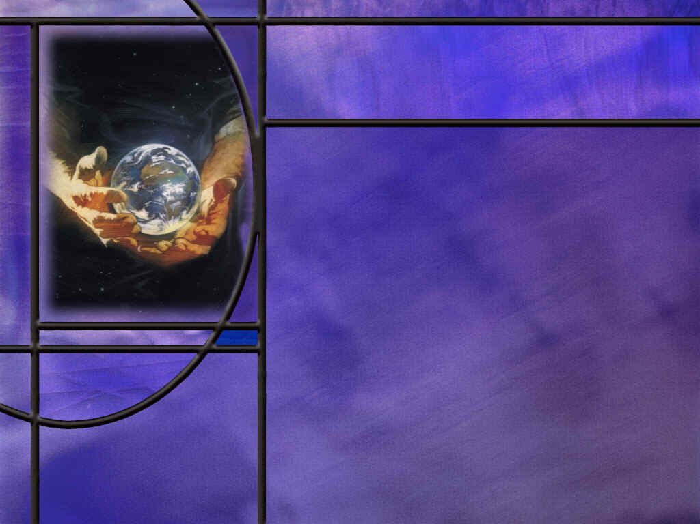
God as Creator
What does the psalmist include in the handiwork of God? (Psalms 8:1,3-6)
How does the psalmist differentiate between he divine and the human in Psalm 100?
What laws of science support the claims of the psalmists that God created the heavens and the earth?
Notes:
B1:
[See notes on linked slide.]
B2:
[See notes on linked slide.]
B3:
1. All scientists today believe that the universe had a beginning.
2. And everything that has a beginning has a cause: This is the Law of Cause and Effect.
3. Creation needs a cause; it needs a Creator.
4. It can no more create itself than we can create ourself.
5. Time, space, and random events are an insufficient cause for the complexity and order of the universe we observe.
6. In fact, time, space, and events are created things; they are not properties of nothingness!
7. The evolutionist Carl Sagan has estimated that the information content of a single cell is equivalent to 100 million pages of the Encyclopedia Britannica (about 10¹² bits).
8. Where does information come from?
9. Can complex information arise from random events?
10. How long would it take a monkey typing on a keyboard to produce the Gettysburg Address (only 268 words)?
11. The DNA in our cells contains all the information to produce all the enzymes and proteins of life.
12. Complex information does not arise by random events.
13. It requires an intelligent source.
14. The DNA must be arranged in just the right way in order for it to be useful.
15. There are many other evidences that indicate that time and chance cannot explain the order we observe in our universe.
16. Just to name some:
1. The Law of Cause and Effect.
2. The fine-tuned physical constants of the universe (Example: Cosmological constant is accurate to 1 part in 10¹²⁰. Slightly larger and the universe would fly apart; slightly smaller and it would collapse.)
3. 1st and 2nd Laws of Thermodynamics (Laws of conservation and universal decay).
4. Law of Biogenesis (Life comes only from life.)
5. Improbability of Life from Chance (Chance formation of bacterial DNA 1 in 10^2,000,000 making very favorable assumptions for evolution.)
6. Information and its Translation (Information requires an intelligent source)
7. The law of Optical Isomers. (Living things use all right-handed or all left-handed molecules; but a mixture of the two is always obtained in the lab.)
8. Irreducible Complexity (Useful biological features such as the eye need to be complete to function at all. Such systems cannot be built up by small changes in simpler systems since the simpler systems do not work and cannot provide an advantage for natural selection.)
9. Short Age Clocks (many consistent with the Biblical age of the earth).
10. The Gaps in the Fossil Record. (There is not just a missing link; there are basically no valid transitional forms in the fossil record.)
17. Note that many of these are laws of science, not theories.
18. The first law of thermodynamics states that the energy of the universe is a constant and can neither be created nor destroyed by natural processes.
19. So where did all the energy come from to power all the stars and galaxies we see today?
20. It had to come from some kind of supernatural process.
21. The first law requires supernatural intervention to start the universe with a vast amount of energy.
22. So all the truly good scientific evidence and arguments are on the side of creation as God’s word and the psalmists declare.
23. As Adventists we stand on the truth of the word of God and make no compromises with the theory of evolution which is a doctrine of the devil if there ever was one.
24. It is part of the First Angel’s message of Revelation 14 where the Adventist movement calls people to “fear God and give glory to Him, for the hour of His judgment is come, and worship Him that made heaven and earth, and the sea, and the fountains of water.”

Slide 5
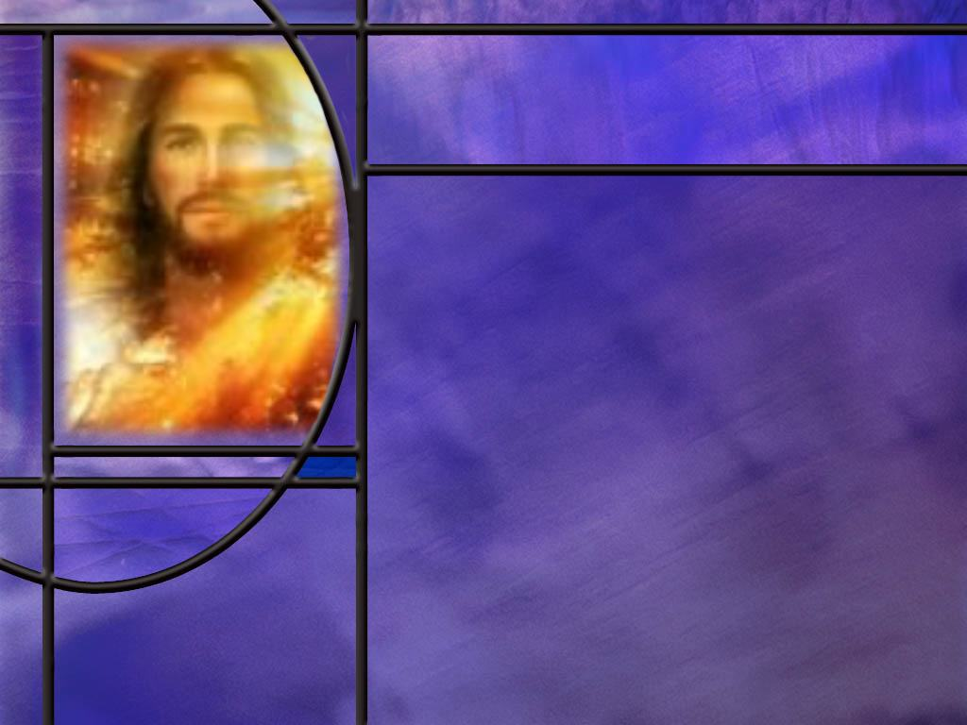
God as King
How does God as Creator lead to an understanding of God as King?
How does Psalm 97 describe the reign of God over His creation? (Ps 97:1,9)
How should our love for God affect our understanding of right and wrong? (Ps 97:10)
Notes:
B1:
1. If God made the universe, to whom does it belong?
2. It belongs to Him.
3. If it belongs to Him, He can do with it what He wants.
4. He can rule and reign over the things He has made since they belong to Him.
B2:
[See notes on linked slide.]
B3:
[See notes on linked slide.]

Slide 6
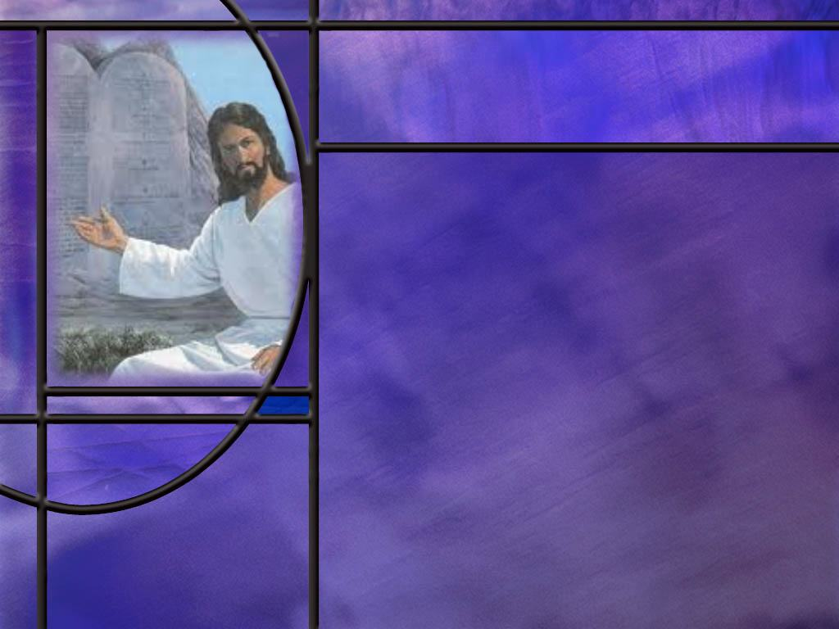
God as Law Giver
How does God as Creator lead to His authority as law giver?
How do the Psalms extol the law of God?
  Ps 1:1-2
  Ps 19:7-11
  Ps 119:165
What advantages and blessings have you found in keeping God’s law?
Notes:
B1:
1. If God is creator of all, and owner of all, He has authority to be King of all.
2. As King of all, He has authority to establish laws that will govern His creation as He sees fit.
3. Fortunately, our God is a God of love, so His law reflects His character of love in establishing guidelines for human behavior.
4. Jesus summarized the Law of God in two great commandments:
Mark 12:30-31 ESV - And you shall love the Lord your God with all your heart and with all your soul and with all your mind and with all your strength.' 31 The second is this: 'You shall love your neighbor as yourself.' There is no other commandment greater than these."
5. God’s moral law is a law of agape love, first toward God, then toward others.
B2:
[See notes on linked slides.]
B3:
1. Many people today think of the law of God as restricting their freedom.
2. But God’s intent in giving us laws to obey was to provide a hedge to protect us from sin and its consequences.
3. Keeping the law is for our own good.
4. Stay out of trouble, stay out of jail, stay out of court, stay away from revenge, by keeping the law.
5. Life is always better when we obey the law of God.
6. Obedience brings blessings; disobedience brings curses.
7. Obeying the health laws brings longer life and a higher quality of life.
8. We can avoid disease and death by our lifestyle choices.
9. Obeying the moral law brings glory to God
10. As God’s people, we make God look good when we obey His commandments and receive His blessings.
Matthew 5:16 (NKJV)
¹⁶ Let your light so shine before men, that they may see your good works and glorify your Father in heaven.
11. Another advantage is that we build our love relationship with Jesus as we live in obedience to His commandments.
12. Jesus said:
John 15:14 (NKJV)
¹⁴ You are My friends if you do whatever I command you.
13. I want to be Jesus’ friend, don’t you?
14. The more we love and obey the Lord, the closer our friendship with Him.

Slide 7
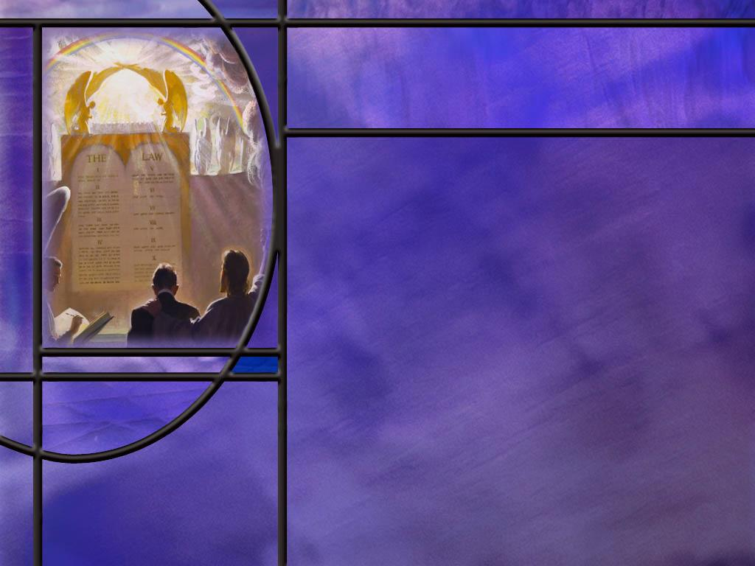
God as Judge
How does God as Creator, King, and Law Giver, lead naturally to God as Judge?
How do the Psalms present the LORD as judge?
  Ps 75:8-10
Notes:
B1:
1. If God is creator of all, and owner of all, He has authority to be King of all.
2. As King of all, He has authority to establish laws that will govern His creation as He sees fit.
3. As Law Giver, He has the authority to judge who is in compliance with the law He has established and who is not.
4. Fortunately, our God is not only a God of love, but He is also a God of mercy and grace.
5. Listen how He described himself to Moses on Mt. Sinai.
Exodus 34:6-7 ESV - The LORD passed before him and proclaimed, "The LORD, the LORD, a God merciful and gracious, slow to anger, and abounding in steadfast love and faithfulness, ⁷ keeping steadfast love for thousands, forgiving iniquity and transgression and sin, but who will by no means clear the guilty, …"
6. So God, as Judge, presides over a judgement that reveals who is guilty of sin and who is forgiven.
B2:
[See notes on linked slide.]

Slide 8
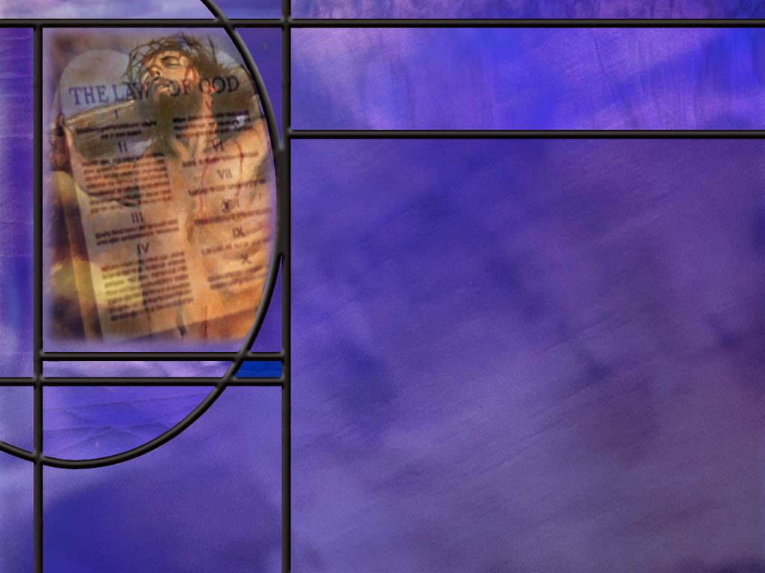
God as Covenant Keeper
How does God as Creator, King, Law Giver, and Judge, lead to God as Covenant Keeper?
How do the Psalms point to God as Covenant Keeper?
  Ps 105:8-10
What is the everlasting covenant of salvation and when was it ratified? (Heb 13:20-21)
Notes:
B1:
1. God’s authority as Creator and owner of all, empowers Him to be King, Law Giver, and Judge.
2. But it is God’s character of love, grace, compassion, and mercy that make Him the Covenant Keeper.
3. And because He is the covenant keeper, He has made a way for sinners to be redeemed.
4. He has cut an everlasting covenant from the foundation of the world by which sinners can be forgiven and saved.
B2:
[See notes on linked slide.]
B3:
[See notes on linked slide.]

Slide 9

Summary
Our lesson this week draws from the book of Psalms five related theological perspectives on the LORD.
When the word “LORD” appears in all caps in our English translations, it denotes “YHWH” in the Hebrew, which is Yahweh, the proper name of God, meaning I AM, the self-existent, ever-present, eternal God.
The psalmists support the creation accounts of Genesis and the fourth commandment in declaring God the creator of the heavens, the earth, the sea, and all they contain.
Some of the most basic laws of science support the conclusion that creation of our universe and life on earth required supernatural processes.

Slide 10
Summary
God as Creator of our universe makes Him owner of all and gives Him rightful authority to reign as King.
Because our LORD reigns we can rejoice with the psalmist knowing the goodness of our God and His plan for our future.
Because God is Creator, Owner, and King, He has authority to establish laws that will govern His creation as He sees fit.
Fortunately, our God is a God of love, so His law reflects His character of love in establishing guidelines for human behavior.
David and other psalmists wax eloquent in extoling the goodness, virtues, values, and blessings of God’s word and His laws.
There is great blessing in keeping the Law.

Slide 11
Summary
Because God is Creator, Owner, King, and Law Giver, He also has authority to judge who is righteous and who is not.
It is the final perspective on God as Covenant Keeper that gives us hope in the judgment.
There is an everlasting covenant of salvation made from the foundation of the world between Father and Son, that should man fall into sin, Jesus would step in the breach and die for our sins, so that we could be forgiven and reconciled to God.
Because Father and Son are faithful to that covenant, we can trust the blood of Jesus for the forgiveness of our sins and eternal life with God.
Will you rejoice with the psalmists today for the redeeming love of our LORD?

Slide 13
Psalm 8:1, 3-6 ESV
O LORD, our Lord, how majestic is your name in all the earth! ... ³ When I look at your heavens, the work of your fingers, the moon and the stars, which you have set in place, ⁴ what is man that you are mindful of him, and the son of man that you care for him? ⁵ Yet you have made him a little lower than the heavenly beings and crowned him with glory and honor. ⁶ You have given him dominion over the works of your hands; you have put all things under his feet, [R]
Notes:
Q1: What all does David here see as the creation of the Lord?
1. The heavens, the moon and the stars, the inanimate objects of the universe.
2. Then in verse 5, it is this same LORD that has made mankind a little lower than the angels.
3. And then the Lord has given mankind dominion over the works of the hands of God and put all things under his feet.
4. So it is the LORD God that is the creator of all things.
5. The psalm goes on to specify cattle and beasts and birds and fish.
6. So God is the creator of everything animate and inanimate.

Slide 14
Psalm 100:1-5 KJV
Make a joyful noise unto the LORD, all ye lands. ² Serve the LORD with gladness: come before his presence with singing. ³ Know ye that the LORD he is God: it is he that hath made us, and not we ourselves; we are his people, and the sheep of his pasture. ⁴ Enter into his gates with thanksgiving, and into his courts with praise: be thankful unto him, and bless his name. ⁵ For the LORD is good; his mercy is everlasting; and his truth endureth to all generations. [R]
Notes:
Q1: Where do we see God as creator in this psalm?
1. Verses 1 and 2 call us to praise God and come into His presence with singing.
2. Verses 4 and 5 call us to do the same.
3. It is in the middle verse, verse 3 that the psalmist gives us his reason for praising the Lord.
4. Here the LORD (all caps), Yahweh, is God, it is He that hath made us and not we ourselves.
Q2: What is totally illogical about the idea of us making ourselves?
1. To make yourself, you would have to exist before you existed!
2. And if you already existed why would your have to make yourself?
3. So the whole idea of making yourself is laughable and silly.
4. It would make a lot more sense if the psalmist had said, “It is He that hath made us and not just our parents.”
5. But eventually, if your go back far enough, you need to account for how our first parents were made, and that absolutely required and act of our Creator God.
6. The fact that He created us with the ability to procreate does not lessen the need for His creation of our first parents.
7. In fact, the whole reproduction process gives us amazing evidence that we were designed by an intelligent God who placed all the information in the DNA of every living kind to make it the life form that He desired it to be.

Slide 15
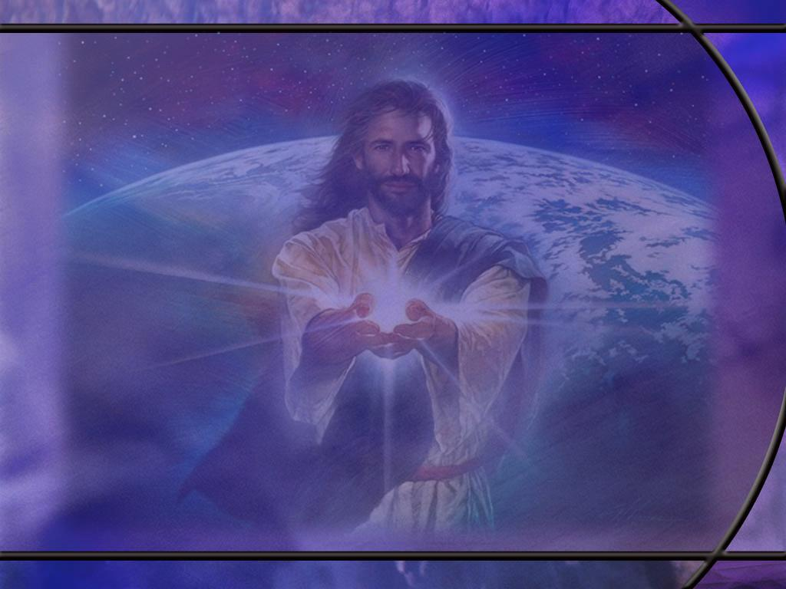
Psalm 97:1, 9 ESV
The LORD reigns, let the earth rejoice; let the many coastlands be glad! ... ⁹ For you, O LORD, are most high over all the earth; you are exalted far above all gods. [R]
Notes:
Q1: What should be our response to the declaration that “the LORD reigns?”
1. We should follow the psalmists cue to rejoice and be glad.
2. Are you glad that Yahweh reigns?
3. We have every reason to be glad and rejoice.
4. Our Creator God is in control of His creation, and He will see it through to a victorious end.
5. We serve a good God who has led us to repentance by His goodness.
6. He will ultimately deliver His people and bring them His salvation.
Q2: What can we say about the other gods that men bow before?
1. The one true living God is far above them.
2. The idols that men worship become the habitation of demons.
3. The apostle Paul writes this in:
1 Corinthians 10:19-20 NKJV - What am I saying then? That an idol is anything, or what is offered to idols is anything? ²⁰ Rather, that the things which the Gentiles sacrifice they sacrifice to demons and not to God, and I do not want you to have fellowship with demons.
4. So while the idols themselves are inanimate objects, they become the habitation of demons who often use the idols to enslave the ones who worship them.
5. The psalmist assures us that our God is far above such demonic principalities and powers and will ultimately vanquish them.
6. Verse 3 of Ps 97 says:
Psalm 97:3 NKJV - 3 A fire goes before Him, And burns up His enemies round about.

Slide 16
Psalm 97:10 NIV
Let those who love the LORD hate evil, for he guards the lives of his faithful ones and delivers them from the hand of the wicked. [R]
Notes:
Q1: Why will those who love the Lord hate evil?
1. Because the Lord hates evil.
2. If we love the Lord, we will love His commandments.
3. Jesus said it in John 14:15:
John 14:15 ESV - "If you love me, you will keep my commandments.”
4. Keeping His commandments is equivalent to hating evil.
5. It is choosing obedience and righteousness rather than choosing sin and evil.

Slide 17
Psalm 1:1-2 ESV
Blessed is the man who walks not in the counsel of the wicked, nor stands in the way of sinners, nor sits in the seat of scoffers; ² but his delight is in the law of the LORD, and on his law he meditates day and night.
Notes:
Q1: According to this psalm, what do we need to do to be blessed and happy?
1. We need to shun evil and delight in the law of God.
2. We need to avoid hanging out with and participating in the evil of the wicked, the sinners, and the scoffers.
3. We need to make the law of God and His word the meditation of our hearts day and night.
Q2: What will be the end result for those who are faithful and obedient to the word of God?
1. Not only will they reap the blessings of obedience in this life, but they will reap eternal blessing in the judgment.
2. Psalm 1 ends with these words.
Psalm 1:5-6 ESV - 5 Therefore the wicked will not stand in the judgment, nor sinners in the congregation of the righteous; 6 for the LORD knows the way of the righteous, but the way of the wicked will perish.
3. So the way of the wicked will perish.
4. By contrast, the way of the righteous will not perish because the Lord knows them and will save them.
5. We are not saved by keeping the law, but the law points out sin so we can come to Christ and receive forgiveness of our sins.
6. When we are justified by faith in Him, we can be among the congregation of the righteous that will not perish.
[Go to next slide.]

Slide 18
Psalm 19:7-11 ESV
The law of the LORD is perfect, reviving the soul; the testimony of the LORD is sure, making wise the simple; 8 the precepts of the LORD are right, rejoicing the heart; the commandment of the LORD is pure, enlightening the eyes; 9 the fear of the LORD is clean, enduring forever; the rules of the LORD are true, and righteous altogether. 10 More to be desired are they than gold, even much fine gold; sweeter also than honey and drippings of the honeycomb. 11 Moreover, by them is your servant warned; in keeping them there is great reward.
Notes:
Q1: Let’s review again all the adjectives David uses in this psalm to describe the law of God.
1. God’s law is perfect, it is sure, it is right, it is pure, it is clean, it is totally true and righteous.
Q2: And what is God’s law able to do for us:
1. It revives our soul, it makes us wise, it rejoices our hearts, it enlightens our eyes, it endures forever.
2. It warns us from evil and brings great reward in obedience.
3. No wonder David describes God’s law as being more precious than gold and sweeter than honey.
[Go to next slide.]

Slide 19
Psalm 119:11, 105, 165 ESV
¹¹ I have stored up your word in my heart, that I might not sin against you. ... ¹⁰⁵ Your word is a lamp to my feet and a light to my path. ... ¹⁶⁵ Great peace have those who love your law; nothing can make them stumble. [R]
Notes:
1. This is just a brief sampling of the many wonderful texts in the book of Psalms extoling the law of God.
Q1: What does it mean to store up God’s word in our hearts?
1. It points to the importance of knowing God’s word including His Law.
2. We could argue here that we really store God’s word in our minds.
3. But thinking of our hearts as the center of our emotions, we should store God’s word in a loving way that recognizes its authority in our lives and calls us to submission to its precepts.
Q2: How do we store the word of God in our hearts and minds?
1. We need to get into the word so the word gets into us.
2. We need to hear the word, read the word, preach the word, teach the word, understand what it says and what it means and how to live in its light.
3. Study the word; pray it in; live it out!
4. Walk in the light of the word.
5. Let it influence your life.
6. Meditate upon it. Recite it. Memorize it. Live it.

Slide 20
Psalm 75:8-10 NIV
In the hand of the LORD is a cup full of foaming wine mixed with spices; he pours it out, and all the wicked of the earth drink it down to its very dregs. ⁹ As for me, I will declare this forever; I will sing praise to the God of Jacob, ¹⁰ who says, "I will cut off the horns of all the wicked, but the horns of the righteous will be lifted up.“ [R]
Notes:
Q1: What two groups do we see here when judgment is poured out?
1. There are only two groups in the judgment: the wicked and the righteous.
2. These two groups see a very different result in the judgment.
3. The wicked are cut off, and the righteous are lifted up.
Q2: How do we get from the wicked group to the righteous group?
1. We all start out in the wicked group.
2. Paul writes this in Romans 3:
Romans 3:10, 23 KJV - As it is written, There is none righteous, no, not one: ... 23 For all have sinned, and come short of the glory of God;
3. But God has an everlasting covenant resulting in the everlasting Gospel.
4. And the everlasting Gospel is that
1 Corinthians 15:3-4 KJV - 3 …Christ died for our sins according to the scriptures; ⁴ And that he was buried, and that he rose again the third day according to the scriptures:
5. And so:
1 John 1:9 KJV - 9 If we confess our sins, he is faithful and just to forgive us our sins, and to cleanse us from all unrighteousness.
6. It is justification by faith in the shed blood of Jesus for the forgiveness of sins and eternal life with God that moves us from the wicked group to the righteous group.
7. And the righteousness we have in the righteous group is not our own, but the righteousness that comes from God imputed to our account.
8. So David can write in Ps 139:
Psalm 139:23-24 KJV - 23 Search me, O God, and know my heart: try me, and know my thoughts: 24 And see if there be any wicked way in me, and lead me in the way everlasting.
9. When we are trusting in Jesus for our forgiveness, we do not have to worry about the judgment.
10. The judgment for the redeemed is good news.
11. It brings vindication of the saints and eternal life in the kingdom of God.

Slide 21
Psalm 105:8-10 ESV
He remembers his covenant forever, the word that he commanded, for a thousand generations, ⁹ the covenant that he made with Abraham, his sworn promise to Isaac, ¹⁰ which he confirmed to Jacob as a statute, to Israel as an everlasting covenant, [R]
Notes:
Q1: What covenant does the psalmist point to in this passage?
1. This is the covenant with Abraham, confirmed to Isaac and Jacob.
2. It was a covenant that gave the land of Canaan to Abraham and his descendants through Isaac.
3. It was a covenant in which all nations of the world would be blessed through Abraham’s seed, meaning Christ.
4. And it is through the Christian church now that the gospel of the Lord Jesus is being carried to every nation, kindred, tongue and people.
5. We are spiritual Israel, serving God as Abraham’s seed.
6. Paul wrote in:
Galatians 3:29 ESV - 29 And if you are Christ's, then you are Abraham's offspring, heirs according to promise.
7. But the Abrahamic covenant was a covenant of service, not a covenant of salvation.
8. And if God is faithful to the Abrahamic covenant, how much more will He be faithful to the everlasting covenant, which is a covenant of salvation.

Slide 22
Hebrews 13:20-21 NLT
Now may the God of peace--who brought up from the dead our Lord Jesus, the great Shepherd of the sheep, and ratified an eternal covenant with his blood-- 21 may he equip you with all you need for doing his will. [R]
Notes:
Q1: Whose blood ratified the eternal or everlasting covenant?
1. It was the blood of Jesus, the great Shepherd of the sheep.
2. So the everlasting covenant is the New Covenant of salvation ratified by the blood of Jesus on the cross of Calvary.
3. And it is because God is faithful to this covenant of salvation that our sins can be forgiven by confessing them and trusting in the blood of Jesus to forgive our sins and give us His righteousness.
4. We have studied the everlasting covenant in previous lessons.
5. What we concluded was that there was an everlasting covenant made between God the Father and God the Son before the world began…
6. That if mankind should fall into sin, the Son would come as man to live in obedience to the Father and die for our sins.
7. He would become our substitute to bear our sins and give us His righteousness.
8. That covenant was made in the courts of heaven before the foundation of the world.
9. And because God is faithful to that covenant our sins can be laid on Jesus our Substitute, and His righteousness can be laid on us.

