Slide 1
Psalms
Lesson 9
Blessed is He Who Comes in the Name of the Lord

Slide 2
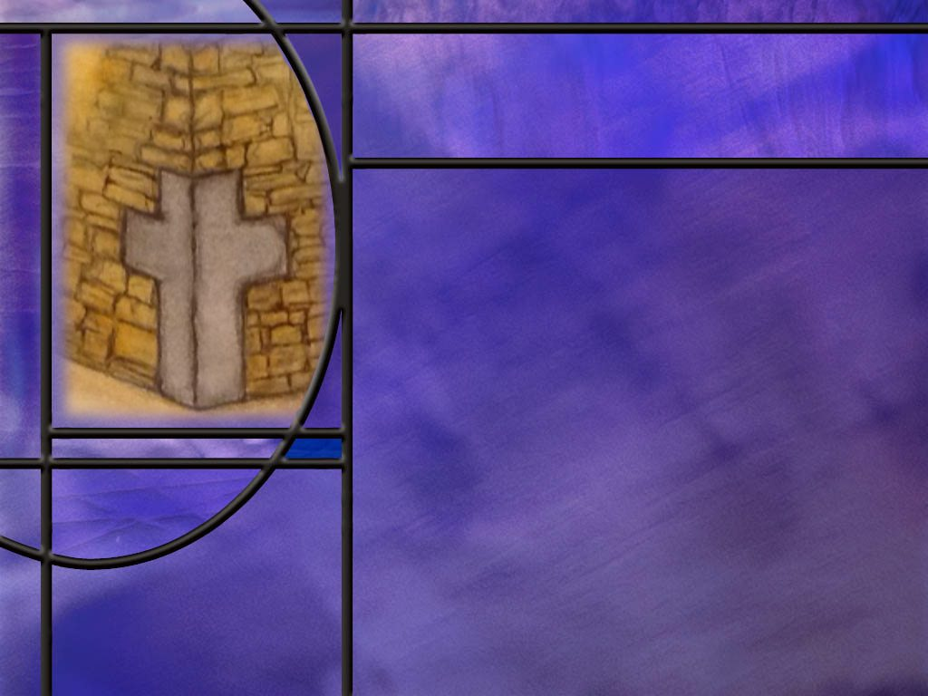
Memory Text
Psalm 118:22-23 NKJV
The stone which the builders rejected Has become the chief cornerstone. ²³ This was the LORD's doing; It is marvelous in our eyes.
Who did Jesus say was the stone that the builders rejected? (Matt 21:42-44)
Notes:
B2:
[See notes on linked slide.]

Slide 3
Overview
The psalms in our lesson this week are inspired prophecies that provide a glimpse of the life, death, resurrection and high priestly ministry of Jesus the Messiah. The fulfillment of these prophecies give us confidence in the Bible as God’s word and in Christ as God’s Son and Savior.
  My Shepherd (Ps 23)
  Suffering Servant (Ps 22)
  LORD and Lord (Ps 110)
  Prophetic Fulfillment
  Summary

Slide 4
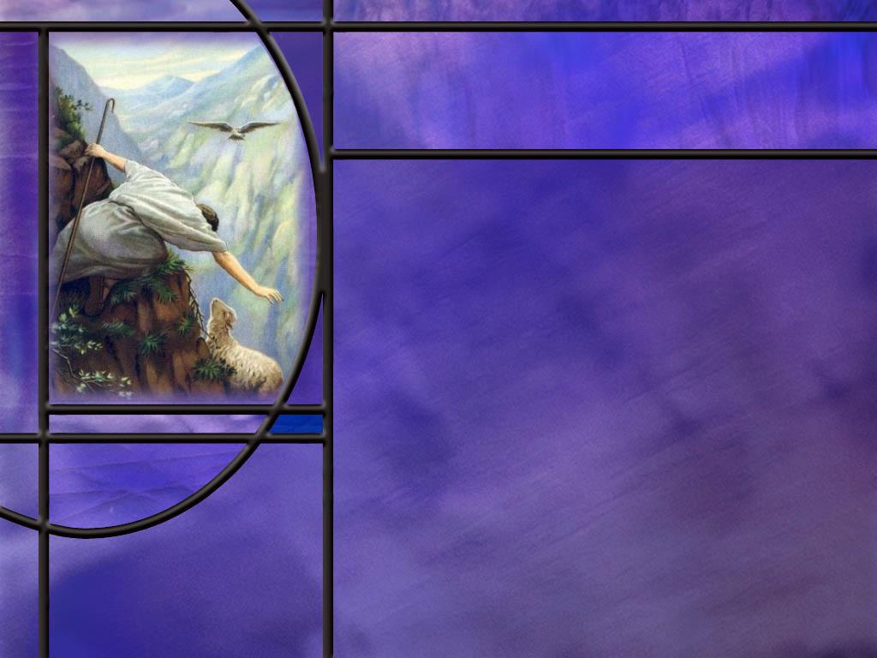
My Shepherd
What is it about the 23rd psalm that makes it a favorite for so many people?
How does the opening words of Psalm 23 summarize its theme? (Ps 23:1)
Where will the Good Shepherd lead us according to Ps 23:3?
How did Jesus portray Himself as the good Shepherd? (John 10:11)
What are the promises of this Psalm to those who are part of the Good Shepherd’s flock? [For what shall I not want?]
Notes:
B1:
1. How many could say this whole psalm by heart?
2. Many of us memorized it as kids and have enjoyed it all of our lives.
3. Why do you love this psalm?
4. Because it paints a beautiful picture of the love and care of God for us.
5. This is a poetic illustration of the goodness of God.
6. It doesn’t just say that God is good.
7. It paints a poetic image of a dependent sheep being tended by a loving shepherd.
8. This is what we call a metaphor; God is like a good shepherd.
9. He is a gracious God, meeting our needs and leading us onward to peace, rest, satisfaction, comfort, victory, blessing, and eternal life.
10. Let me quote a description of this psalm from the Tyndale Bible site:
“God is a zealous protector of his sheep, training us to hear his voice, leading us into pleasant pastures, and even walking with us through the darkest valleys. And he is extravagant in his goodness. He doesn’t just feed us; he prepares a feast in the presence of our enemies. He doesn’t just bless us; he fills our cup to overflowing. He doesn’t just offer his goodness and love; he pursues us with them. We aren’t simply his assignment; we are his passion—forever.”
[Why is the 23rd Psalm So Beloved? – Tyndale Bibles]

Slide 5
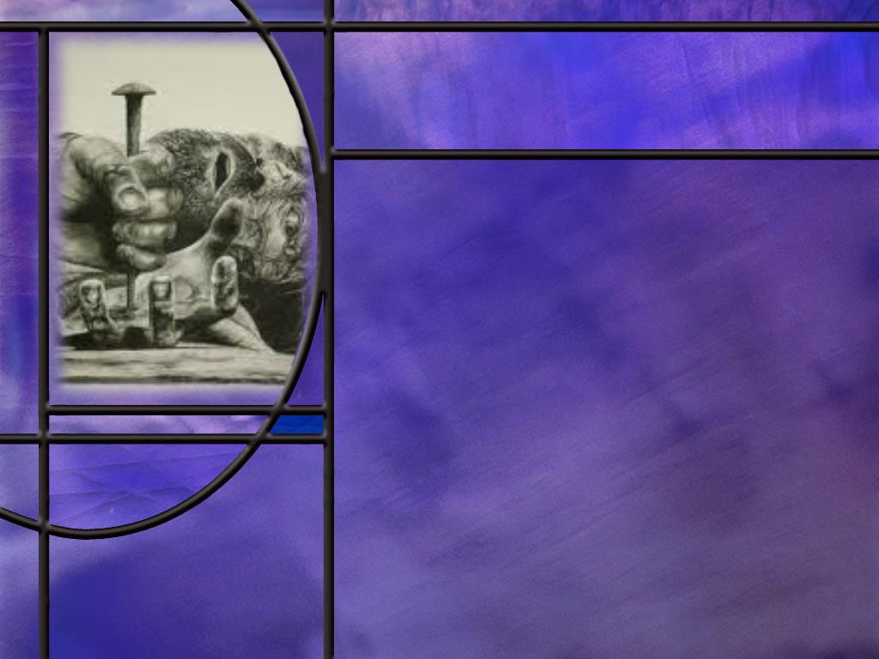
Suffering Servant
What did Jesus tell the disciples on the road to Emmaus about Messianic prophecy? (Luke 24:25-27)
How did Jesus emphasize that same message with other disciples that same evening? (Luke 24:44-45)
What amazing predictions did David make about the agony of Christ as he was crucified on Calvary? Ps 22:1,6-8,14-18
Notes:
B1:
[See notes on linked slide.]
B2:
[See notes on linked slide.]
B3:
[See notes on linked slide.]

Slide 6
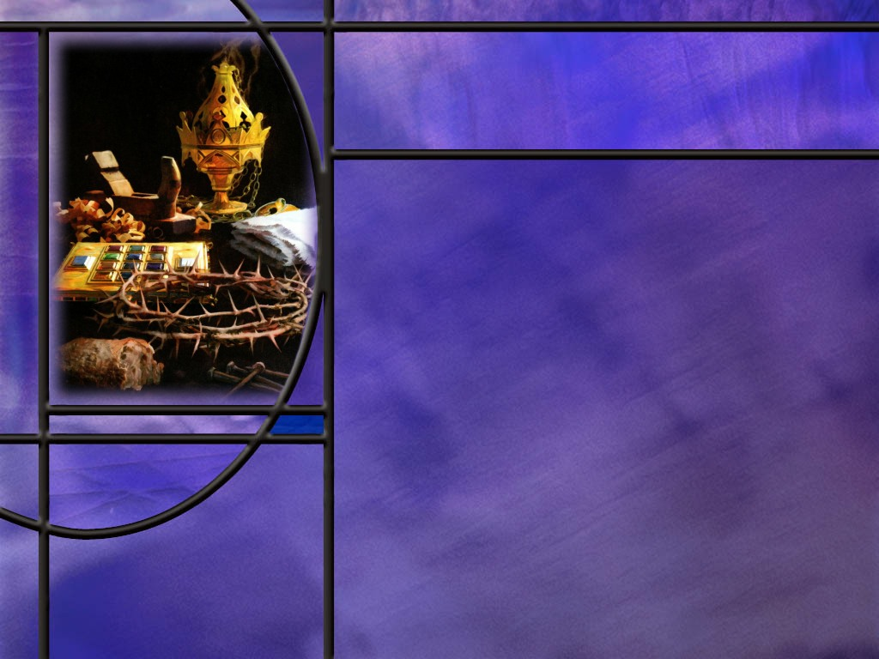
LORD and Lord
What does David write about a divine conversation in Ps 110? (Ps 110:1)
How did Jesus use this scripture to stymie the Pharisees that were trying to trap Him? (Matt 22:41-46)
In addition to making the Son King of kings, what else does the Father promise Him? (Ps 110:4)
Notes:
B1:
[See notes on linked slide.]
B2:
[See notes on linked slide.]
B3:
[See notes on linked slide.]

Slide 7
Prophetic Fulfillment in Psalms
PROPHECY | FULFILLMENT
Psalm 8:2 ESV - 2 Out of the mouth of babies and infants, you have established strength because of your foes, to still the enemy and the avenger. | Matthew 21:16 ESV - 16 And Jesus said to them, "Yes; have you never read, "'Out of the mouth of infants and nursing babies you have prepared praise'?"
Psalm 16:10 ESV - 10 For you will not abandon my soul to Sheol, or let your holy one see corruption. | Matthew 28:5-6 ESV - 5 But the angel said to the women, “… I know that you seek Jesus who was crucified. 6 He is not here, for he has risen, as he said.
Psalm 34:20 ESV - 20 He keeps all his bones; not one of them is broken. | John 19:33 ESV - 33 But when they came to Jesus and saw that he was already dead, they did not break his legs.
Notes:
[If time is short, just read the prophecy and give the fulfillments below rather than reading the NT texts.]
1. Ps 8:2 Fulfilled at the Triumphal Entry.
2. Ps 16:10 Fulfilled at the resurrection of Jesus.
3. Ps 34:20 Fulfilled at the crucifixion

Slide 8
Prophetic Fulfillment in Psalms
PROPHECY | FULFILLMENT
Psalm 35:19 ESV - 19 Let not those rejoice over me who are wrongfully my foes, and let not those wink the eye who hate me without cause. | John 15:25 ESV - 25 But the word that is written in their Law must be fulfilled: 'They hated me without a cause.'
Psalm 41:9 ESV - 9 Even my close friend in whom I trusted, who ate my bread, has lifted his heel against me. | Luke 22:48 ESV - 48 but Jesus said to him, "Judas, would you betray the Son of Man with a kiss?"
Psalm 69:21 NIV - 21 They put gall in my food and gave me vinegar for my thirst. | Matthew 27:34 ESV - 34 they offered him wine to drink, mixed with gall, but when he tasted it, he would not drink it.
Notes:
1. Ps 35:19 Fulfilled at the trial of Jesus and the crucifixion.
2. Ps 41:9 Fulfilled by Judas Iscariot.
3. Ps 69:21 Fulfilled in the crucifixion

Slide 9
Prophetic Fulfillment in Psalms
PROPHECY | FULFILLMENT
Psalm 109:8 ESV - 8 May his days be few; may another take his office! | Acts 1:20, 26 ESV - 20 "For it is written in the Book of Psalms, ""'Let another take his office.' ... 26 And they cast lots for them, and the lot fell on Matthias,
Psalm 110:1 ESV - 1 The LORD says to my Lord: "Sit at my right hand, until I make your enemies your footstool." | Matthew 22:45 ESV - 45 If then David calls him Lord, how is he his son?"
Psalm 110:4 ESV - 4 The LORD has sworn and will not change his mind, "You are a priest forever after the order of Melchizedek." | Hebrews 6:20 ESV - 20 where Jesus has gone …, having become a high priest forever after the order of Melchizedek.
Notes:
1. Ps 109:8 Fulfilled in the selection of Matthias take Judas’ place
2. Ps 110:1 Fulfilled in the ascension and enthronement of Jesus.
3. Ps 110:4 Fulfilled in the high priestly ministry of Christ.

Slide 10
Prophetic Fulfillment in Psalms
PROPHECY | FULFILLMENT
Psalm 118:22 ESV - 22 The stone that the builders rejected has become the cornerstone. | Matthew 21:42 ESV - 42 Jesus said to them, "Have you never read in the Scriptures: "'The stone that the builders rejected has become the cornerstone?
Psalm 118:26 ESV - 26 Blessed is he who comes in the name of the LORD! We bless you from the house of the LORD. | Matthew 21:9 ESV - 9 And the crowds that went before him and that followed him were shouting, "Hosanna to the Son of David! Blessed is he who comes in the name of the Lord! Hosanna in the highest!"
Notes:
1. Ps 118:22 Fulfilled in the establishment of the Christian church
2. Ps 118:26 Fulfilled at the triumphal entry.

Slide 11
Prophetic Fulfillment in Ps 22
Verses that can be related directly to the suffering of Jesus at the crucifixion:
  Ps 22:1-2
  Ps 22:6-8
  Ps 22:11-18
These include, feeling forsaken of God, being scorned, despised, stared at, gloated over, and mocked, being encompassed by “beasts,” poured out like water, bones out of joint, heart melted like wax, strength dried up, thirsty, dying, encompassed by dogs and evildoers, hands and feet pierced, bones protruding, garments divided, and lots cast for clothing.
Notes:
1. This describes a suffering far beyond what David ever experienced himself.
2. But we see all of these prophecies fulfilled beautifully in the suffering of Christ at the crucifixion.

Slide 12

Summary
The psalms in our study this week are prophetic, finding their fulfillment in Christ.
The 23rd Psalm is probably the most often read and best loved of all the psalms. It paints a beautiful picture of the love and care of God for us.
The theme is stated in the very first line: “The Lord is my shepherd, I have all that I need.” The remainder of the psalm expands on this idea.
This psalm can be understood prophetically as pointing to Jesus who said, “I am the good shepherd. The good shepherd lays down his life for the sheep.”
When Jesus is our Savior and Lord, God supplies all of our “need according to His riches in glory by Christ Jesus.”

Slide 13
Summary
A thousand years before Christ was born, David penned Ps. 22 that provides amazing details about Christ’s suffering at Calvary.
The exact fulfillment of these details according to the gospel accounts is dramatic proof that the Bible is God’s word, Jesus is God’s Son, and God is able to bring to pass what He says.
There are many other psalms that find their fulfillment in Christ: He is the cornerstone that the builders rejected, He is the Lord of King David that will reign as King of kings and High Priest forever.
Other psalms predict the actual words spoken in praise at the Triumphal Entry, that He would be betrayed by a friend, and hated without cause at His trial.

Slide 14
Summary
Other psalms predict that Christ would be given gall and vinegar to drink, that His bones would not be broken, and that He would be raised from the dead.
After His resurrection, Jesus emphasized the importance of fulfilled prophecy to His disciples, first on the road to Emmaus and then to His disciples, including the 11, that same night as He “opened their minds so they could understand the Scriptures.”
The importance of prophetic fulfillment is seen in the words of Jesus who said, “I have told you now before it happens, so that when it does happen you will believe.”
Seeing in these psalms the fulfillment of Messianic prophecy will you believe that the Bible is God’s word, that Jesus is God’s Son, and that God is able to do what He says?

Slide 16
Matthew 21:42-44 KJV
Jesus saith unto them, Did ye never read in the scriptures, The stone which the builders rejected, the same is become the head of the corner: this is the Lord's doing, and it is marvelous in our eyes? 43 Therefore say I unto you, The kingdom of God shall be taken from you, and given to a nation bringing forth the fruits thereof. 44 And whosoever shall fall on this stone shall be broken: but on whomsoever it shall fall, it will grind him to powder. [R]
Notes:
Q1: What parable did Jesus tell the chief priests and Pharisees before quoting this scripture to them?
1. It was the parable of the wicked tenants that tended the vineyard of the landowner and refused to return to him any of the fruit produced.
2. It was the landowner that had planted the vineyard, built a hedge around it, dug a winepress, and built a watchtower.
3. But the tenants refused to give the landowner his share of the produce, beating, stoning, or killing the servants he sent.
4. Finally the landowner sent his Son, thinking that surely they will respect Him.
5. But the threw Him out of the vineyard and killed Him thinking they would have the inheritance for themselves.
Q2: So when Jesus quoted this scripture, who was the stone that the builders rejected?
1. It was the Son, the Messiah, that the tenants had thrown out of the vineyard and killed.
2. The builders that rejected the stone were the wicked tenants who tried to steal the Son’s inheritance.
3. And the tenants in the parable were the religious leaders that rejected Jesus as the Messiah.
4. So Jesus is making a prophecy here.
5. He says the kingdom of God shall be taken from the Jewish leaders that reject God’s Messiah and will be given to a new nation, the Christian church, that Jesus Himself will establish.
6. The stone that the Jewish leaders rejected will become the cornerstone of a new movement that includes all that will receive the Messiah as Savior and Lord.
Q3: What do you think Jesus meant in verse 44? [read verse 44] What does it mean to fall on the Stone or fall on the Rock or fall on Jesus?
1. It means to recognize our sinfulness and our need of a Savior.
2. It means to fall down at the feet of Jesus and repent of our pride, our self-sufficiency, and our sin and admit that we need Him to forgive us and save us.
3. To be broken means to be broken-hearted for our sin.
4. So either we fall on the Rock or the Rock falls on us.
5. All those who refuse to fall on the Rock will be ground to powder, or destroyed, when the Rock presides over the judgment of the wicked.

Slide 17
Psalm 23:1 KJV
The LORD is my shepherd; I shall not want. [R]
Notes:
1. When I was a kid I always thought this verse said, in effect, “The Lord is my shepherd that I shall not want.” Or “I shall not want the Lord to be my shepherd.”
2. And I would think, “Why wouldn’t I want the Lord to be my shepherd?”
3. Even today, I have to force myself to understand it correctly.
4. My natural habit is to go back to my childhood understanding.
5. It’s not that we don’t want our shepherd, it’s that, when we have our Shepherd, we shall have no wants in life.
6. So the more modern translations make it perfectly clear.
7. NIV: The LORD is my shepherd, I lack nothing.
8. NLT: The LORD is my shepherd; I have all that I need.
Q2: How does this first line summarize the theme of this psalm?
1. The rest of the psalm is simply an expansion of this idea.
2. It recounts the many ways in which the good shepherd meets all of our needs.
3. All that we hope for, all that we need, all that God has promised, it’s all found in Jesus Christ, our Good Shepherd.
Q3: As David expands on this theme of being satisfied with the Lord’s provision, what essentials does he cite in the next verse?
Psalm 23:2 KJV - He maketh me to lie down in green pastures: he leadeth me beside the still waters.
1. Our Good Shepherd knows where to find the best grass and the best water.
2. He protects us as we eat and drink, allowing the sheep to rest in perfect peace and tranquility.
3. David here reminds us that God will meet our needs for food and water.
4. Jesus reminds us of the same thing.
Matthew 6:33 KJV - But seek ye first the kingdom of God, and his righteousness; and all these things shall be added unto you.

Slide 18
Psalm 23:3 KJV
He restoreth my soul: he leadeth me in the paths of righteousness for his name's sake. [R]
Notes:
Q1: In the second phrase of this verse, where does our Good Shepherd lead us?
1. He leads us in the paths of righteousness.
2. What is righteousness?
3. Righteousness is doing what is right.
4. The Lord leads us to do what is right.
5. Would that involve obeying His commandments?
6. Would that involve loving Him with all our heart, mind, soul, and strength?
7. Would that involve loving others as ourselves?
8. Absolutely.
Q2: When our Good Shepherd leads us in the paths of righteousness, is this righteousness imputed or imparted righteousness?
1. This is imparted righteousness, sanctification, growing in grace to be more like Jesus.
2. Imputed righteousness is the righteous of Christ.
3. It is His perfect life of right doing, lived out on earth 2000 years ago, that is placed to our account by faith.
4. Imparted righteousness is the (imperfect) life of right doing that we live out daily as a result of the Spirit of God dwelling in us.
5. Forgiveness of our sins by the blood of Christ and His imputed righteousness is what saves us.
6. Imparted righteousness does not save us but is an act of love to God and brings glory to Him.
7. Imputed righteousness is for our justification, imparted righteousness is for our sanctification.
8. Justification is our title to heaven, sanctification is our fitness for heaven.
Q3: What does it mean to you that the Lord restores my soul?
1. We think of the soul as the essence of our being.
2. God breathed into Adam’s nostrils and he became a living soul.
3. Our soul represents the essence of our life: physical, mental, emotional, spiritual.
4. Our soul is who we are: our world view, our values, our character, our hopes and aspirations.
5. To retore my soul, we could say, means to restore my life.
6. We can think of that in physical terms as alluded to in the green pastures and still waters.
7. But we can also think of it in spiritual terms.
8. Our relationship with God is restored when our sins are forgiven and we are justified by faith.
Romans 5:1 KJV - Therefore being justified by faith, we have peace with God through our Lord Jesus Christ:
9. As we take in the spiritual nourishment of meditating on the word and communing with the Lord in prayer, our spiritual life is restored.
10. We see God’s plan and purpose for our lives.
11. Our relationship to our Good Shepherd, as sheep of His flock, gives our lives meaning and hope.
12. Loving, trusting, and following our Good Shepherd will bring us home at last.
13. As David writes in the final line of this psalm: “And I will dwell in the house of the Lord forever.”

Slide 19
John 10:11 ESV
I am the good shepherd. The good shepherd lays down his life for the sheep. [R]
Notes:
Q1: What is the greatest provision that our Good Shepherd has made for us?
1. He has taken our sins on Calvary’s cross so that we can be forgiven and receive eternal life.
2. This meets our greatest need: to be forgiven of our sins.
3. This is the essence of the gospel: Christ died for our sins.
4. He died that we might live.
5. The Good Shepherd made the ultimate sacrifice for His sheep.
6. And when we hear the Gospel of what Christ has done to save us, we can choose to trust in Him for the forgiveness of our sins and have eternal life.
7. When we become part of His flock, He says in this same chapter that we will hear his voice and follow Him.
8. That means He becomes not just our Savior but our Lord as well.
9. We follow Him by living in obedience to His word.
Q2: When we become part of the Good Shepherd’s flock by faith in Him, what can we know about the promises of the 23rd Psalm?
1. All the promises of God are fulfilled in a relationship with Jesus Christ.
2. Jesus becomes our Good Shepherd.
3. He meets all of our needs:
4. The apostle Paul writes in:
Philippians 4:19 KJV - But my God shall supply all your need according to his riches in glory by Christ Jesus.
5. We can truly be satisfied when Jesus is our Savior and Lord.

Slide 20
For What Shall I Not Want?
I shall not want for:
  Rest -- for He makes me to lie down in green pastures.
  Peace -- for He leads me beside the still waters.
  Forgiveness -- for He restores my soul.
  Guidance -- for He leads me in the paths of righteousness.
  Companionship -- for He is with me.
  Comfort -- for His rod and staff comfort me.
  Provision -- for He prepare a table before me.
  Joy -- He anoints my head with oil and my cup runs over.
  Everything in time -- for goodness and mercy shall follow me.
  Everything in eternity -- for I shall dwell in the house of the LORD forever. [R]
Notes:
Does that should good to you?
Are you trusting in Jesus today and enjoying the blessings this psalm promises to us?

Slide 21
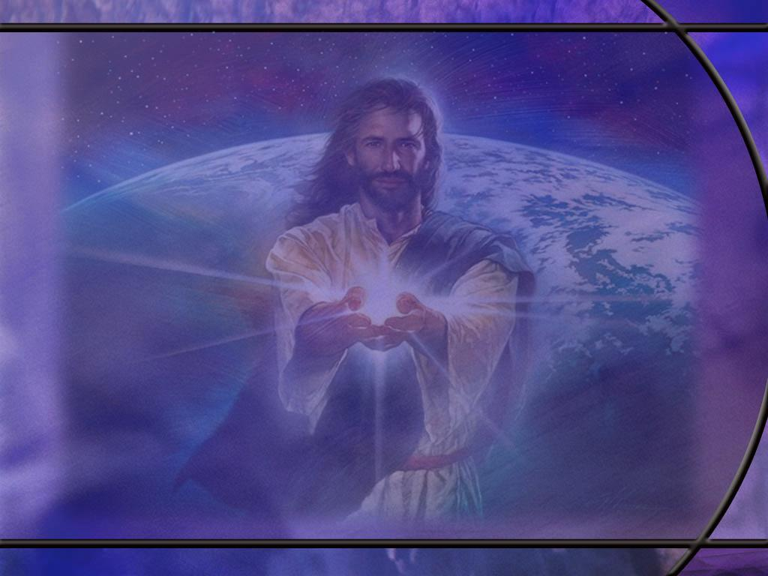
Luke 24:25-27 KJV
Then he said unto them, O fools, and slow of heart to believe all that the prophets have spoken: ²⁶ Ought not Christ to have suffered these things, and to enter into his glory? ²⁷ And beginning at Moses and all the prophets, he expounded unto them in all the scriptures the things concerning himself. [R]
Notes:
Q1: Why did Jesus call them fools?
1. Because they had failed to believe all that the prophets had spoken about the Messiah.
2. They were looking for a military leader to vanquish the Romans, but that’s not what the prophets had predicted the Messiah would be.
3. Jesus accomplished much more than they were expecting.
4. At the cross, He vanquished Satan and eternal death for all who would believe and lay their sins on Him.
5. Instead of a military Messiah, He was a suffering Messiah who took our place and suffered for our sins.
6. They would have understood that if they had read Isaiah 53 about the Suffering Servant.
Q2: To what did Jesus turn to open the eyes of these two disciples?
1. He started with Moses, probably in Gen 3:15, and He continued through all the other books of the OT Scripture.
2. And what did He do?
3. He expounded or explained to them all the prophecies that were written concerning himself.
4. He didn’t just quote verses, He explained how He would fulfill all of the Messianic prophecies.
5. Now that is a Bible study that I would have loved to be a part of.
6. How about you?

Slide 22
Luke 24:44-45 (NIV)
⁴⁴ He said to them, “This is what I told you while I was still with you: Everything must be fulfilled that is written about me in the Law of Moses, the Prophets and the Psalms.” ⁴⁵ Then he opened their minds so they could understand the Scriptures. [R]
Notes:
Q1: How does Jesus refer to scripture in this text?
1. The Law of Moses, the Prophets, and the Psalms.
2. Here Jesus specifically includes the Psalms as containing Messianic prophecies.
3. And we know there are many.
4. The Sadducees of Jesus day accepted only the first five books of the Bible, but Jesus accepted the same OT books as we have in our Bibles today.

Slide 23
Psalm 22:1, 6-8, 14-18 NKJV
My God, My God, why have You forsaken Me? Why are You so far from helping Me, And from the words of My groaning? ... 6 But I am … a reproach of men, and despised by the people. 7 All those who see Me ridicule Me; They shoot out the lip, they shake the head, saying, 8 "He trusted in the LORD, let Him rescue Him; Let Him deliver Him, since He delights in Him!" ... 14 I am poured out like water, And all My bones are out of joint; My heart is like wax; It has melted within Me. 15 My strength is dried up like a potsherd, And My tongue clings to My jaws; You have brought Me to the dust of death. 16 For dogs have surrounded Me; The congregation of the wicked has enclosed Me. They pierced My hands and My feet; 17 I can count all My bones. They look and stare at Me. 18 They divide My garments among them, And for My clothing they cast lots. [R]
Notes:
Q1: What is amazing about this Psalm?
1. This is a psalm written by David 1,000 years before Jesus was born.
2. This description of the crucifixion fits the facts perfectly.
3. It is as though he was an eyewitness of what Jesus went through.
4. The psalm begins with the very words that Jesus spoke from the cross.
5. He describes what it was like, with his bones out of joint and his bones protruding.
6. It even describes his hands and feet being pierced.
7. And this was some 900 years before the Romans came on the world stage with crucifixion as their means of executing criminals.
8. And look at the ending prophecy: “They divide my garments among them, and for My clothing they cast lots.”
9. That almost sounds contradictory, but John describes how they divided His clothes into four piles, but when they came to His robe, it was seamless so they cast lots for it.
Q2: What conclusions do you draw from this prophecy so clearly fulfilled in the crucifixion of Jesus?
1. To me, it is more proof that the Bible is God’s word, and Jesus is God’s Son.
2. In prophecy, God tells us long before it happens, what is going to come to pass.
3. Then He acts to bring it about so we may believe.
John 14:29 ESV - And now I have told you before it takes place, so that when it does take place you may believe.
4. God speaking through Isaiah:
Isaiah 46:11 NKJV - Indeed I have spoken it; I will also bring it to pass. I have purposed it; I will also do it.
5. The greatest objective evidence of the truth of God’s word is fulfilled Bible prophecy.

Slide 24
Psalm 110:1 ESV
[A Psalm of David.] The LORD says to my Lord: "Sit at my right hand, until I make your enemies your footstool." [R]
Notes:
Q1: Who are the persons in this conversation recorded by David?
1. When we see the LORD in all caps, to whom does it refer?
2. It refers to YHWH, Yahweh, the personal name of God.
3. So we would take Yahweh to be God the Father.
4. To whom does the other Lord refer here?
5. David refers to Him as my Lord.
6. The Hebrew for Lord here is Adon (aw-done’).
7. It is defined by Strong’s as sovereign, i.e. controller (human or divine):—lord, master, owner.
8. It is not too hard to figure out who this second Lord is, because what does Yahweh say to Him?
9. And who sits at the right hand of God the Father? It is the resurrected and ascended Lord Jesus Christ.
10. And the day is coming when His enemies will be made His footstool, when He returns in glory and they are slain by the glory of His power.
11. So we can take this as a conversation between the Father and the Son.
12. The conversation goes on in verses 2 and 3 as the Father designates the Son as King and ruler, saying:
Psalm 110:2 ESV The LORD sends forth from Zion your mighty scepter. Rule in the midst of your enemies!
13. So here we have the Son of God as the King of kings, who will rule the earth and defeat the forces of evil at His return.

Slide 25
Matthew 22:41-46 NIV
While the Pharisees were gathered together, Jesus asked them, 42 "What do you think about the Messiah? Whose son is he?" "The son of David," they replied. 43 He said to them, "How is it then that David, speaking by the Spirit, calls him 'Lord'? For he says, 44 " 'The Lord said to my Lord: "Sit at my right hand until I put your enemies under your feet." ' 45 If then David calls him 'Lord,' how can he be his son?" 46 No one could say a word in reply, and from that day on no one dared to ask him any more questions. [R]
Notes:
Q1: What argument is Jesus making here?
1. If the Messiah is the physical descendant of David, how could David call him Lord?
2. The term lord would be used for the father or the ancestor, not the descendant.
3. So here Jesus is indicating that the Messiah was more than just a normal human being with an earthly father and mother.
4. And this goes back to another prophecy concerning the Messiah
Micah 5:2 NKJV - 2 "But you, Bethlehem Ephrathah, Though you are little among the thousands of Judah, Yet out of you shall come forth to Me The One to be Ruler in Israel, Whose goings forth are from of old, From everlasting."
5. So the Messiah who would come out of Bethlehem at the incarnation would be the Word that was with God in the beginning.

Slide 26
Psalm 110:4 NKJV
The LORD has sworn And will not relent, "You are a priest forever According to the order of Melchizedek.“ [R]
Notes:
Q1: In addition to being King of kings, what else did Yahweh promise His Son?
1. He would be a priest of highest rank, according to the order of Melchizedek.
2. The writer of Hebrews clearly validates the fulfillment of this covenant promise with these words:
Hebrews 6:19-20 ESV - We have this as a sure and steadfast anchor of the soul, a hope that enters into the inner place behind the curtain, ²⁰ where Jesus has gone as a forerunner on our behalf, having become a high priest forever after the order of Melchizedek.
3. Hebrews points out that the high priesthood of Jesus is superior to the human priests that had to offer sacrifices for their own sins and were subject to death.
4. Jesus is ever interceding for us in the heavenly sanctuary.

